Slide 1

INDIAN PREMIER LEAGUE
Data Analysis

Slide 2
INTRODUCTION
The Indian Premier League (IPL) is a professional Twenty20 cricket league in India, widely regarded as one of the most popular and lucrative T20 leagues globally. Launched in 2008 by the Board of Control for Cricket in India (BCCI), the IPL features franchise teams representing different cities. Known for its high-octane cricket, star-studded line-ups, and innovative formats, the IPL has become a cricketing extravaganza, attracting top international players.
With its blend of entertainment and competitive cricket, the IPL has not only revolutionized the sport but has also gained a massive fan base, making it a premier event in the cricketing calendar.

Slide 3
FIRST EDITION
IPL OVERVIEW
2008
FORMAT
The Indian Premier League (IPL) premier Twenty20 cricket league in India. Renowned for its high-energy matches and star-studded teams representing cities, the IPL has become a global cricketing phenomenon. With innovative formats and top international players, it blends entertainment and competition, captivating a massive fan base. The IPL has redefined modern cricket, elevating it beyond a sport to a cultural spectacle.
Twenty20
NUMBER OF TEAMS
TEN ( 10 )
ADMINISTRATOR
BCCI
( Board of Control for Cricket in India )
HEADQUARTERS
Cricket Centre, Churchgate,
Mumbai, Maharashtra

Slide 4

PROBLEM STATEMENT
1.Conduct an IPL data analysis using the "Matches" and "Deliveries" tables.
2.Utilize robust querying, data mining, and analytics techniques to extract extensive insights from the IPL dataset.
3.Focus on key aspects such as:
Calculating batting statistics
Deriving comprehensive bowling statistics
Profiling top player performances
Analyzing team-wise performance
Identifying impactful partnerships and individual

Slide 5
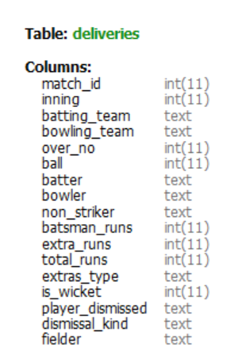
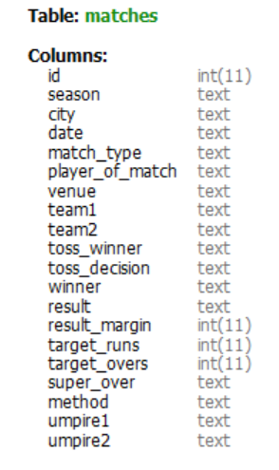
TABLE DETAILS
Tables –
1. deliveries
2. matches

Slide 6
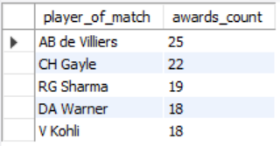
DATA INSIGHTS
Q1. WHAT ARE THE TOP 5 PLAYERS WITH THE MOST PLAYER OF THE MATCH AWARDS?
QUERY -
SELECT player_of_match, COUNT(*) as
awards_count FROM matches
GROUP BY player_of_match
ORDER BY awards_count DESC LIMIT 5;
OUTPUT -

Slide 7
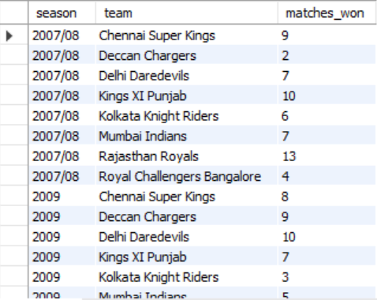
DATA INSIGHTS
Q2. HOW MANY MATCHES WERE WON BY EACH TEAM IN EACH SEASON?
QUERY -
SELECT season, winner as team, COUNT(*) as matches_won
FROM matches
GROUP BY season,team
order by season;
OUTPUT -

Slide 8

DATA INSIGHTS
Q3. WHAT IS THE AVERAGE STRIKE RATE OF BATSMEN IN THE IPL DATASET?
QUERY -
SELECT AVG(strike_rate) AS avg_strike_rate
FROM (SELECT batter, (SUM(total_runs) /count(ball))*100 as strike_rate FROM deliveries GROUP BY batter) AS batter_stats;
OUTPUT -

Slide 9
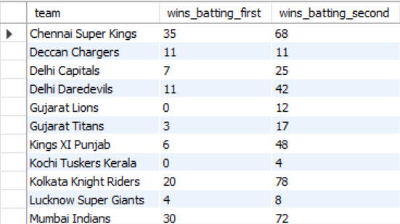
DATA INSIGHTS
Q.4 WHAT IS THE NUMBER OF MATCHES WON BY EACH TEAM BATTING FIRST VERSUS BATTING SECOND?
QUERY -
SELECT winner AS team,
SUM(CASE WHEN toss_winner = winner AND toss_decision = 'bat' THEN 1 ELSE 0 END) AS wins_batting_first,
SUM(CASE WHEN (toss_winner = winner AND toss_decision = 'field') OR (toss_winner != winner AND toss_decision = 'bat') THEN 1 ELSE 0 END) AS wins_batting_second
FROM matches
GROUP BY winner;
OUTPUT -

Slide 10

DATA INSIGHTS
Q.5 WHICH BATSMAN HAS THE HIGHEST STRIKE RATE (MINIMUM 150 RUNS SCORED)?
QUERY -
SELECT batter, (SUM(batsman_runs)/count(*))*100 as strike_rate
FROM deliveries
GROUP BY batter
HAVING SUM(batsman_runs) >=150
ORDER BY strike_rate DESC
LIMIT 1;
OUTPUT -

Slide 11
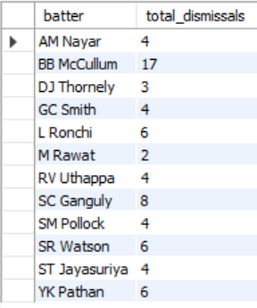
DATA INSIGHTS
Q.6 HOW MANY TIMES HAS EACH BATSMAN BEEN DISMISSED BY THE BOWLER 'Pravin Kumar'?
QUERY -
SELECT batter, count(*) as total_dismissals
FROM deliveries
WHERE player_dismissed is not null and bowler = 'P Kumar'
GROUP BY batter;
OUTPUT -

Slide 12
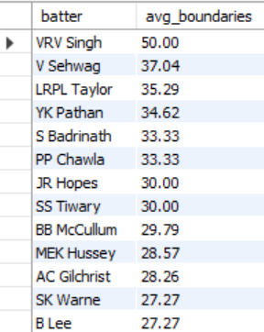
DATA INSIGHTS
Q.7 WHAT IS THE AVERAGE PERCENTAGE OF BOUNDARIES (FOURS AND SIXES COMBINED) HIT BY EACH BATSMAN?
QUERY -
SELECT batter,
ROUND(AVG(case when batsman_runs = 4 or batsman_runs = 6 THEN 1 ELSE 0 END)*100,2) as avg_boundaries
FROM deliveries
GROUP BY batter
ORDER BY avg_boundaries desc;
OUTPUT -

Slide 13
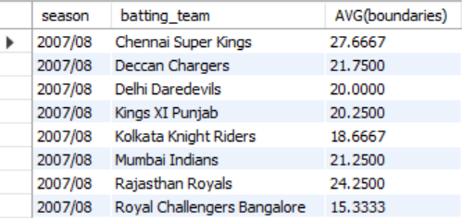
DATA INSIGHTS
Q.8 WHAT IS THE AVERAGE NUMBER OF BOUNDARIES HIT BY EACH TEAM IN EACH SEASON?
QUERY -
SELECT season,batting_team, AVG(boundaries)
FROM (SELECT season, match_id, batting_team,
SUM(CASE WHEN batsman_runs = 4 or batsman_runs = 6 THEN 1 ELSE 0 END) AS boundaries
FROM deliveries
JOIN matches ON matches.id = deliveries.match_id
GROUP BY season,match_id,batting_team) as team_boundaries
GROUP BY season,batting_team;
OUTPUT -

Slide 14
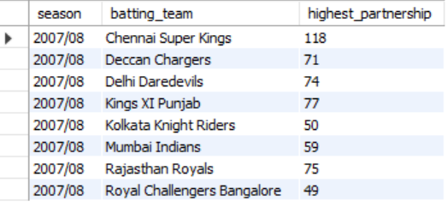
DATA INSIGHTS
Q.9 WHAT IS THE HIGHEST PARTNERSHIP (RUNS) FOR EACH TEAM IN EACH SEASON?
QUERY -
select season,batting_team,max(total_runs) as highest_partnership
from(select season,batting_team,partnership,sum(total_runs) as total_runs
from(select season,match_id,batting_team,over_no,
sum(batsman_runs) as partnership,sum(batsman_runs)+sum(extra_runs) as total_runs
from deliveries,matches where deliveries.match_id=matches.id
group by season,match_id,batting_team,over_no) as team_scores
group by season,batting_team,partnership) as highest_partnership
group by season,batting_team;
OUTPUT -

Slide 15
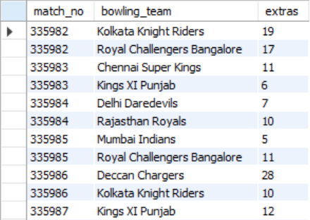
DATA INSIGHTS
Q.10 HOW MANY EXTRAS (WIDES & NO-BALLS) WERE BOWLED BY EACH TEAM IN EACH MATCH?
QUERY -
SELECT m.id as 'match_no',d.bowling_team,
SUM(d.extra_runs) as extras
FROM matches m
JOIN deliveries d on d.match_id = m.id
WHERE extra_runs >0
GROUP BY m.id,d.bowling_team;
OUTPUT -

Slide 16

DATA INSIGHTS
Q.11 WHICH BOWLER HAS THE BEST BOWLING FIGURES (MOST WICKETS TAKEN) IN A SINGLE MATCH?
QUERY -
SELECT m.id, d.bowler, count(*) as wicket_taken
FROM matches m
JOIN deliveries d on d.match_id = m.id
WHERE d.player_dismissed is not null
GROUP BY m.id, d.bowler
ORDER BY wicket_taken DESC LIMIT 1;
OUTPUT -

Slide 17
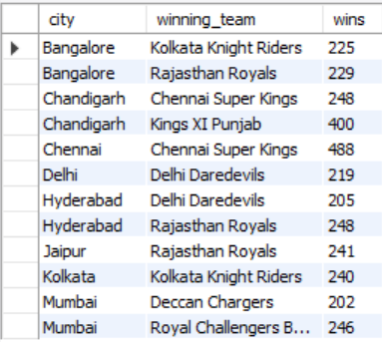
DATA INSIGHTS
Q.12 HOW MANY MATCHES RESULTED IN A WIN FOR EACH TEAM IN EACH CITY?
QUERY -
select m.city,case when m.team1=m.winner then m.team1
when m.team2=m.winner then m.team2
else 'draw'
end as winning_team,
count(*) as wins
from matches as m
join deliveries as d on d.match_id=m.id
where m.result!='Tie'
group by m.city,winning_team;
OUTPUT -

Slide 18
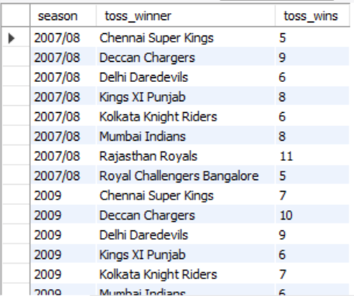
DATA INSIGHTS
Q.13 HOW MANY TIMES DID EACH TEAM WIN THE TOSS IN EACH SEASON?
QUERY -
select season,toss_winner,count(*) as toss_wins
from matches group by season,toss_winner;
OUTPUT -

Slide 19
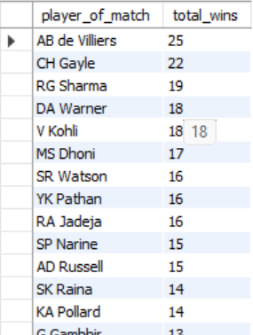
DATA INSIGHTS
Q.14 HOW MANY MATCHES DID EACH PLAYER WIN THE "PLAYER OF THE MATCH" AWARD?
QUERY -
SELECT player_of_match, COUNT(*) as total_wins
FROM matches
WHERE player_of_match IS NOT NULL
GROUP BY player_of_match
ORDER BY total_wins DESC;
OUTPUT -

Slide 20
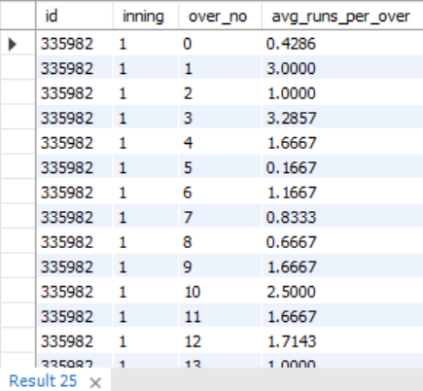
DATA INSIGHTS
Q.15 WHAT IS THE AVERAGE NUMBER OF RUNS SCORED IN EACH OVER OF THE INNINGS IN EACH MATCH?
QUERY -
SELECT m.id, d.inning, d.over_no,
AVG(d.total_runs) as avg_runs_per_over
FROM matches m
JOIN deliveries d on d.match_id = m.id
GROUP BY m.id, d.inning, d.over_no;
OUTPUT -

Slide 21

DATA INSIGHTS
Q.16 WHICH TEAM HAS THE HIGHEST TOTAL SCORE IN A SINGLE MATCH?
QUERY -
SELECT m.id, m.season, d.batting_team,
SUM(d.total_runs) as 'total_score'
FROM matches m
JOIN deliveries d on d.match_id = m.id
GROUP BY m.id,m.season,d.batting_team
ORDER BY total_score DESC LIMIT 1;
OUTPUT -

Slide 22

DATA INSIGHTS
Q.17 WHICH BATSMAN HAS SCORED THE MOST RUNS IN A SINGLE MATCH?
QUERY -
SELECT m.id, m.season, d.batter as batsman,
SUM(d.batsman_runs) as runs
FROM matches m
JOIN deliveries d ON d.match_id = m.id
GROUP BY m.id, m.season, d.batter
ORDER BY runs DESC LIMIT 1;
OUTPUT -

Slide 23
THANK YOU
Linkedin: www.linkedin.com/in/itsdineshmadhav
Github : https://github.com/Its-Dinesh-Madhav

